Slide 1

Hypothesis Testing 2
Abdullah Qayyum

Slide 2
Highest Mean of Buyers Age
Ram has the highest mean age of buyers.
After applying the tapply() method to calculate the mean of buyers age for every car brand.
To calculate the level of significance we calculate by 0.05/10 we get 0.005 since, we are doing 10 permutations and comparing Ram’s Buyers age mean to the other 10 car brands buyers age mean .

Slide 3
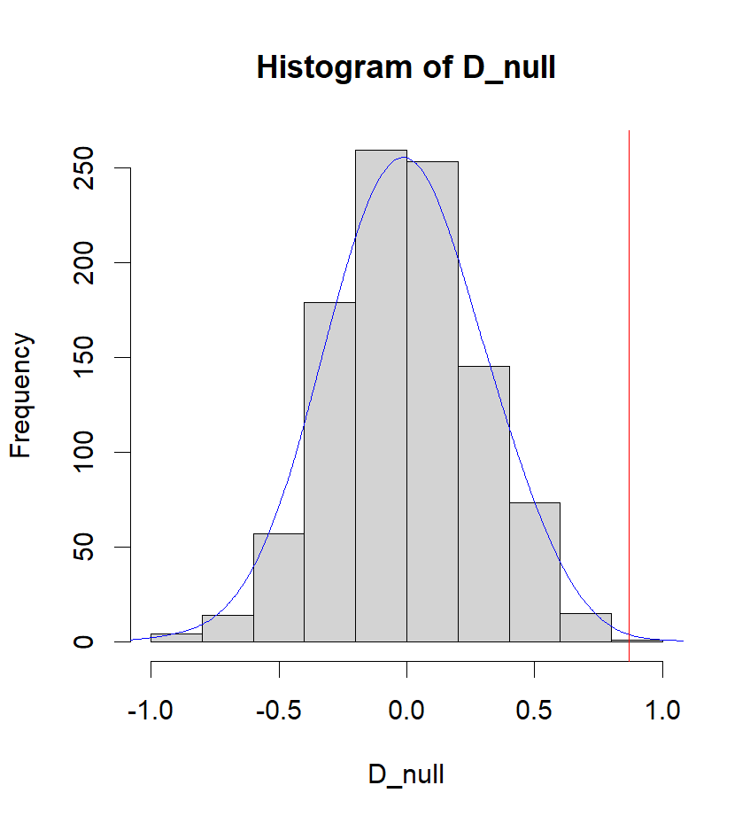
Ram vs Chevrolet
Null Hypothesis
There is no difference between the buyers age mean of Chevrolet and Ram.
Since the p value I got after running the permutation test is 0.002 which lower then the 0.005 which is our significance level. So, we can reject the null hypothesis.
Alternative Hypothesis:
The buyers age mean of Ram is higher than Chevrolet.

Slide 4
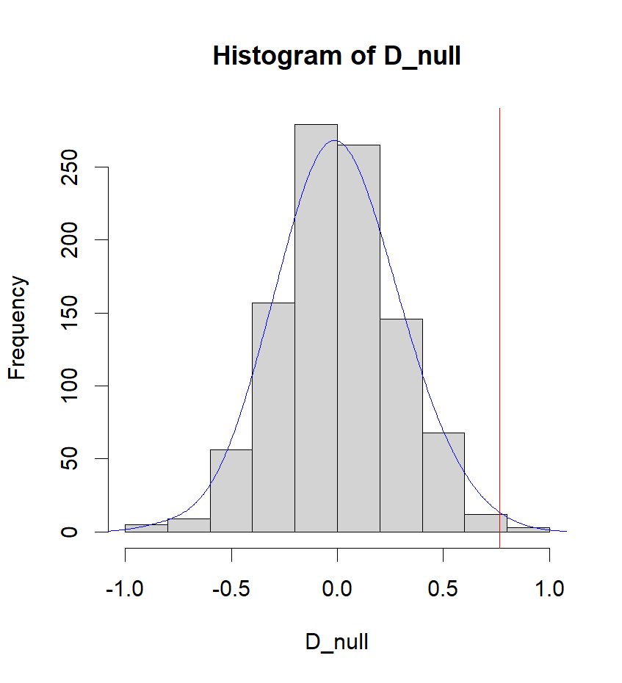
Ram vs Ford
Null Hypothesis
There is no difference between the buyers age mean of Ford and Ram.
Since the p value I got after running the permutation test is 0.003 which is lower than the 0.005 which is our significance level. So, we can reject the null hypothesis.
Alternative Hypothesis:
The buyers age mean of Ram is higher than Ford.

Slide 5
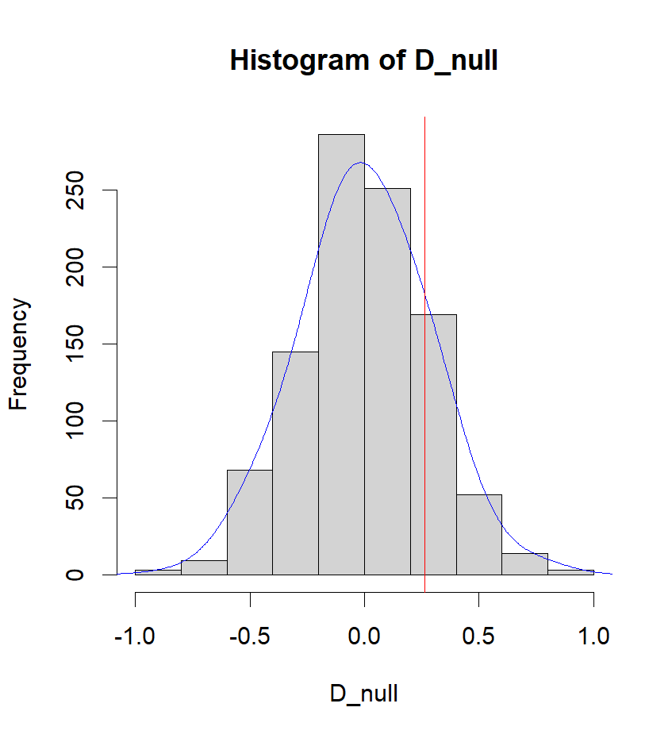
Ram vs GMC
Null Hypothesis
There is no difference between the buyers age mean of GMC and Ram.
Since the p value I got after running the permutation test is 0.173 which is higher than the 0.005 which is our significance level. So, we can not reject the null hypothesis.

Slide 6
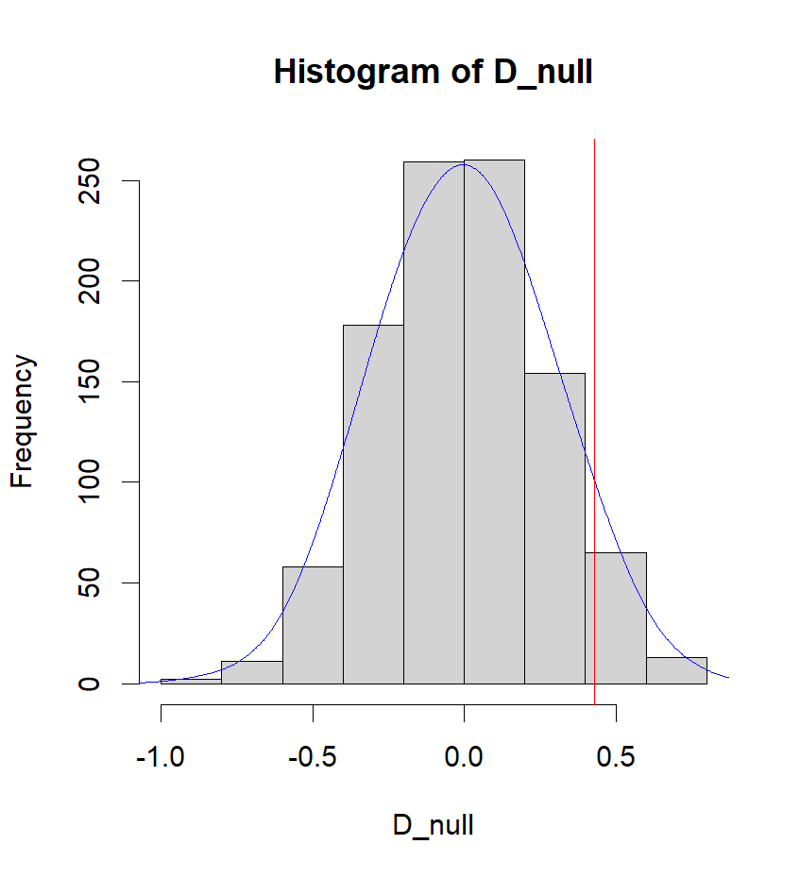
Ram vs Honda
Null Hypothesis
There is no difference between the buyers age mean of Honda and Ram.
Since the p value I got after running the permutation test is 0.064 which is higher than the 0.005 which is our significance level. So, we can not reject the null hypothesis. We don’t not have enough level of significance in our evidence to support our Alternative Hypothesis that the mean of Ram is indeed higher than Honda.

Slide 7
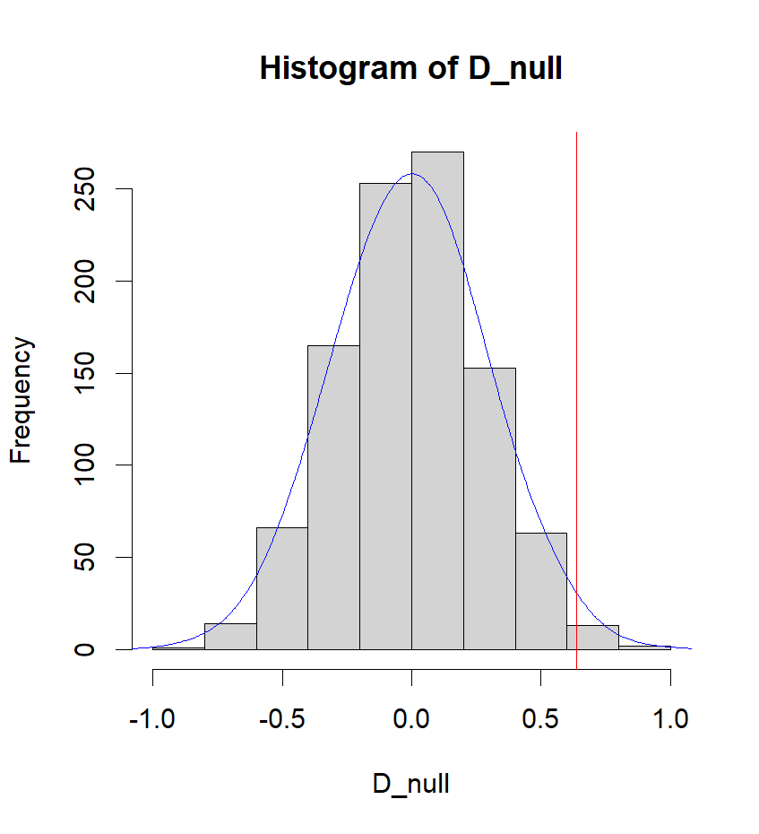
Ram vs Hyundai
Null Hypothesis
There is no difference between the buyers age mean of Hyundai and Ram.
Since the p value I got after running the permutation test is 0.009 which is higher than the 0.005 which is our significance level. So, we can not reject the null hypothesis.

Slide 8
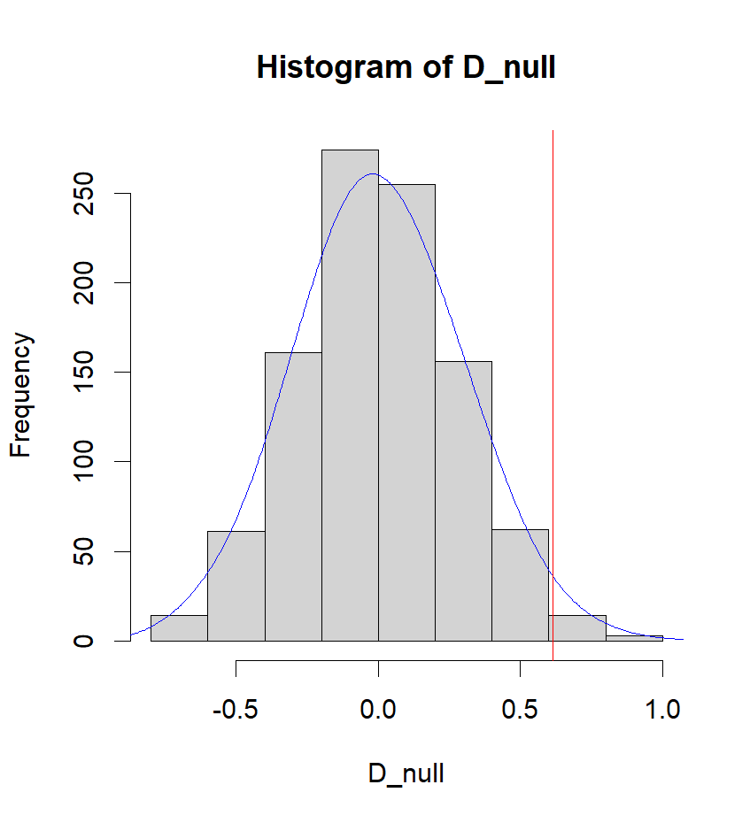
Ram vs Jeep
Null Hypothesis
There is no difference between the buyers age mean of Jeep and Ram.
Since the p value I got after running the permutation test is 0.017 which is higher than the 0.005 which is our significance level. So, we can not reject the null hypothesis.

Slide 9
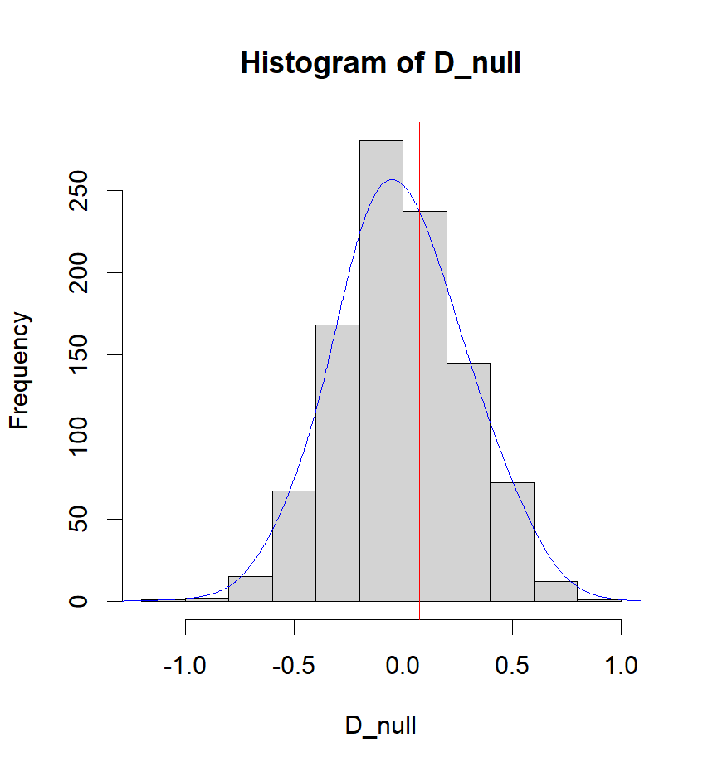
Ram vs Kia
Null Hypothesis:
There is no difference between the buyers age mean of Kia and Ram.
Since the p value I got after running the permutation test is 0.369 which is higher than the 0.005 which is our significance level. So, we can not reject the null hypothesis and do not have enough strength in our evidence to support the alternative that Ram buyers age mean is higher.

Slide 10
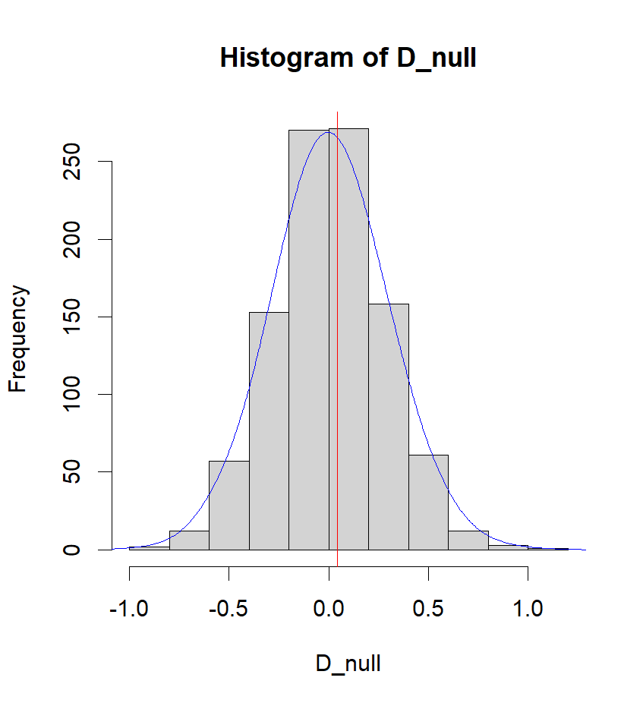
Ram vs Nissan
Null Hypothesis:
There is no difference between the buyers age mean of Nissan and Ram.
Since the p value I got after running the permutation test is 0.435 which is higher than the 0.005 which is our significance level. So, we can not reject the null hypothesis and do not have enough strength in our evidence to support the alternative that Ram buyers age mean is higher.

Slide 11
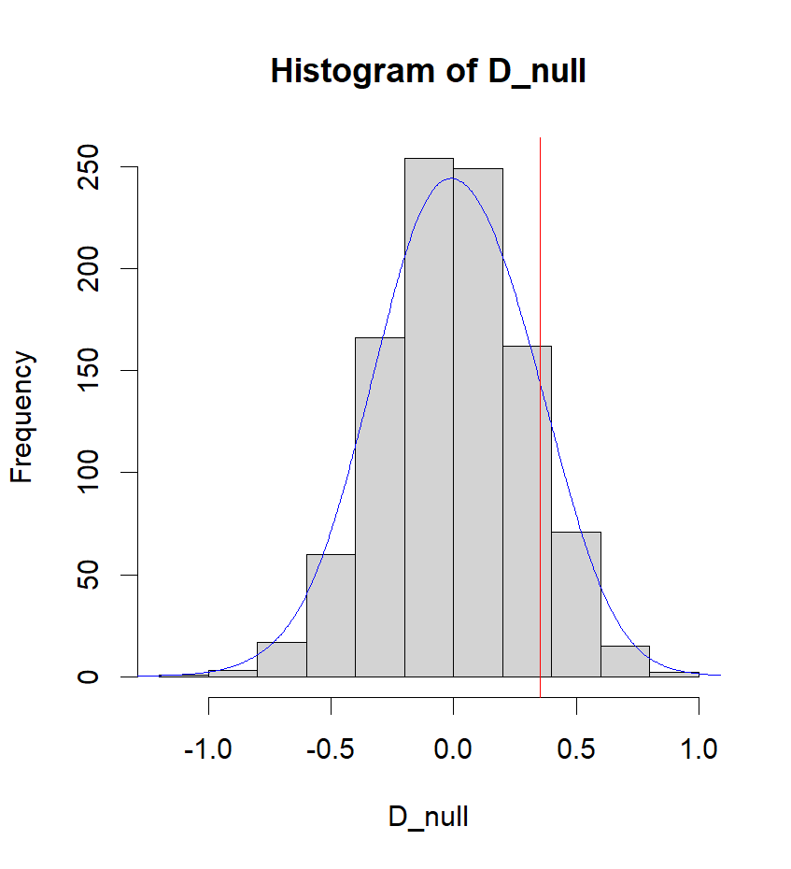
Ram vs Subaru
Null Hypothesis:
There is no difference between the buyers age mean of Subaru and Ram.
Since the p value I got after running the permutation test is 0.114 which is higher than the 0.005 which is our significance level. So, we can not reject the null hypothesis and do not have enough strength in our evidence to support the alternative hypothesis that Ram buyers age mean is higher.

Slide 12
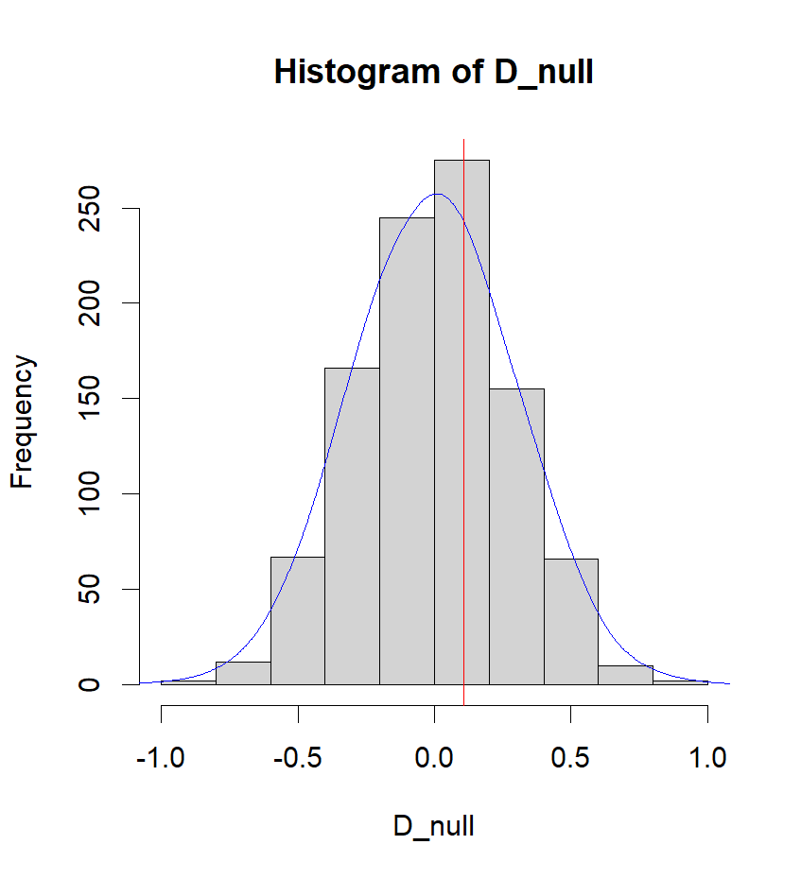
Ram vs Toyota
Null Hypothesis:
There is no difference between the buyers age mean of Toyota and Ram.
Since the p value I got after running the permutation test is 0.34 which is higher than the 0.005 which is our significance level. So, we can not reject the null hypothesis and do not have enough strength in our evidence to support the alternative hypothesis that Ram buyers age mean is higher.

Slide 13

Conclusion
In summary, I conducted a series of permutation tests to evaluate whether the mean age of Ram buyers differed significantly from that of buyers of other car brands in the dataset. After running 10 permutation tests, I found that in only 2 instances, the p-value fell below the predefined significance level of 0.005, leading to the rejection of the null hypothesis in those cases and support for the alternative hypothesis. Nevertheless, it's important to note that we cannot confidently assert that Ram consistently has the highest mean buyer age, as these differences may have arisen due to random fluctuations within the dataset.

